Slide 1
PPG Analyzer 9800FX
Timo, Mirva, Miloš

Slide 2



The team!
Timo Lauteslager BSc. – born in 1990, finished his bachelor in Biomedical engineering, currently part of CEMACUBE programme
Mirva Reijonen – born in 1990, has a bachelor in Chemical engineering, currently in student exchange in Czech Republic
Miloš Kaćanski Ing. – born in 1989, got his degree in Biochemical engineering, currently part of CEMACUBE programme

Slide 3
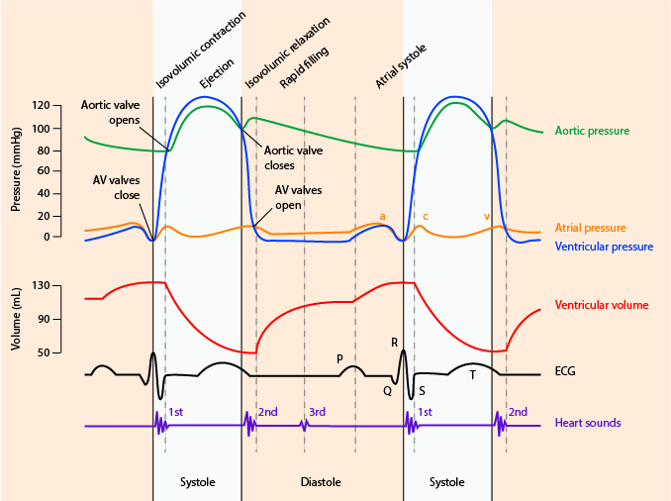
PPG
Photoplethysmography (PPG) is an optical measurement technique that can be used to detect blood volume changes in the microvascular bed of tissue

Slide 4
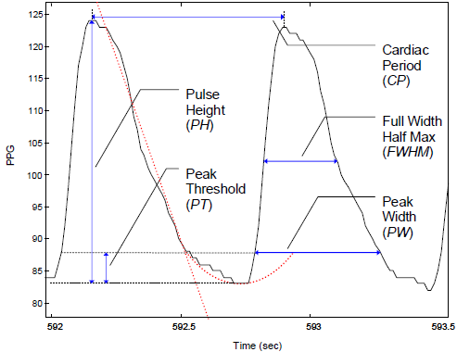
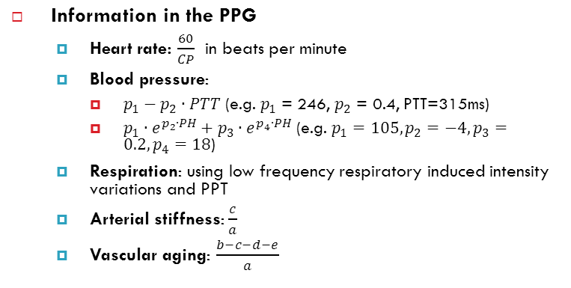
Structure of the PPG Signal
Parameters in the PPG signal
PH: pulse height or pulse amplitude
CP: cardiac period
FWHM: full width half max
PW: peak width
PT: peak threshold

Slide 5
The project
Digital filtering of a raw PPG signal
Extraction of PH (pulse height) and PP (peak-to-peak) values from a filtered PPG signal
MAP estimation using PH
Fourier transform of PP intervals and estimation of HF and LF
Implementation in Matlab, if possible with an interactive GUI
User should be able to import the raw signal import from a Biopac text export
User should be able to enter the sampling frequency,
User should be able to filter the raw signal
User should be able to execute PP, PH, MAP, LF, HF computation
User should be able to display plots of the raw signal for a given start and end timestamp
User should be able to display plots of PP, PH, MAP over the time for a given start and end timestamp and display the value of LF and HF

Slide 6
The signal
Data for project design was:
From a superficialy healthy subject treated with Czech culture for last nine months, with some interuptions
Recorded by Biopack SS4LA plethysmograph transducer
Exported into text file with Biopack student lab PRO software
Analysed in Mathlab, version 2011a

Slide 7
Heart rate estimation
Filtering with a strong FIR low pass filter
FIR for linear phase characteristics
Peak detection
Removal of small intervalls
Lower than 0.6 mean interval
Determination of mean Heart rate

Slide 8
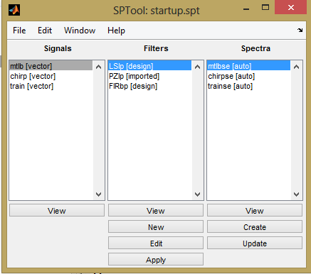
Digital filtering of a raw PPG signal
FIR low pass (experimentaly determined values using Sptool ):
Passband Frequency= 1
Stopband Frequency= 12
Passband Ripple= 0.057
Stopband Attenuation= 0.003
Density Factor= 20

Slide 9
Extraction of PH (pulse height) and PP (peak-to-peak) values from a filtered PPG signal
Using the filtered data
Peak detection using minimal peak distance
Minimal peak distance intelligently set after heart rate
Intervals are determined for PP interval
For Pulse height:
Peak detection of negative signal
Positive and negative peaks are sorted
Difference between peak values are calculated
Removal of all even data

Slide 10
MAP estimation using PH
*Using mean peak height

Slide 11
Fourier transform of PP intervals and estimation of HF and LF
Doubling of Fs
Fast Fourier transform of peak to peak intervals
Interpolation of the amplitude spectrum
Integration of HF and LF intervals
LF: 0.04 – 0.15 Hz
HF: 0.15 – 0.5 Hz

Slide 12
Implementation in Matlab
[sound of Matlab opening]

Slide 13
Discussion
Strengths:
Every physician can use it without background knowledge
Low number of mathematical operations -> Fast
Easily user-adaptable
User can evaluate peak detection
Possible improvements
Program is not compatibility-tested with different operating systems and Matlab versions
Parameters are set after 1 PPG data set, validation with other sets required
Stand-alone program
Added functions: HR, PA, MAP, Amplitude spectrum over a user-defined interval

Slide 14
Questions?

